Slide 1
Welcome To Presentation
By The Great Presenter

Slide 2

Merry Christmas!

Slide 3
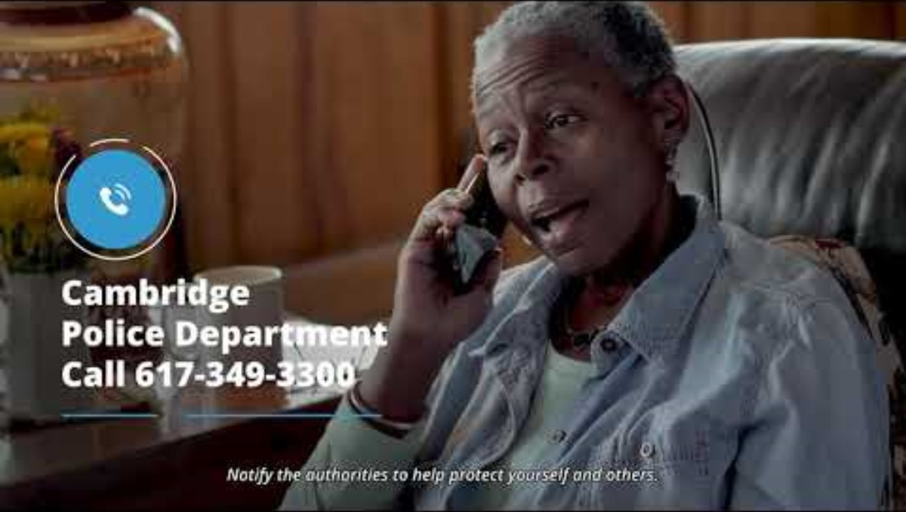
COVID-19 Vaccine Scam Awareness

Slide 4
The Timeline of Product Release
Initiation
Negotiation
Standardization
Debriefing
Handing over
January
February
March
April
May
Opportunities:
Negotiating during initiation
Less time in standardization
Handing over before debriefing

Slide 5
The Process of Product Release
Initiation
Handing over
Negotiation
Debriefing
Standardization
Advantages:
Quick
Efficient
Cost-saving

